Slide 1
RAJALAKSHMI ENGINEERING COLLEGE
Department of Information Technology
FIRST REVIEW
DETECTION OF PLANT DISEASE USING IMAGE PROCESSING AND IMAGE RECOGNITION
Supervisor Irumporai A
M.Tech-CSE Assistant Professor
Project by,
Ramkumar K (181001072)
Vijay Bharathwaj G (181001113)
Ajay Dhiwakar S (181001501)

Slide 2
OBJECTIVE
The goal of this project is to implement a Plant Disease detection system using image processing and image recognition with the help of Artificial Neural Network(ANN).
Plant disease can directly lead to stunted growth causing bad effects on yields and economic losses In addition, traditional methods mainly rely on specialists, experience, and manuals, but the majority of them are expensive, time-consuming, and labor-intensive with difficulty detecting precisely.

Slide 3
ABSTRACT
This project proposes a disease detection and classification algorithm with the assistance of machine learning mechanisms and image recognition tools and also integrates this algorithm with an android application.
Identifying and recording the contaminated area comes first, followed by image
preprocessing then the infected area is identified and feature extraction
is performed on the same.
And then the image is processed by the Artificial neural network to
identify whether the image of the leaf under supervision is diseased or not.
Plant disease identification can help farmers not just to increase yields and moreover help in increasing the GDP.

Slide 4
INTRODUCTION TO PROBLEM DOMAIN
Image processing is a method to perform operations on an image in order to improve it for further analysis.
The most common way image processing is performed into a computer vision system is the following:
Image acquisition: The camera and sensors take an image and digitize it in order to process it.
Pre-processing: Performing basic processing tasks in order to have a suitable image to work with.

Slide 5
INTRODUCTION TO PROBLEM DOMAIN
Processing: Here the techniques required for the correct modification of the image are applied.
Representation and description: extracting the most particular features of the objects from the already processed image, in order to differentiate these objects.
Recognition and interpretation: assigning labels to those objects to completely define them.

Slide 6
EXISTING SYSTEM
In Existing System ,To recognize apple leaf disease, Wang P, Zang z proposed a correlation-based feature selection approach in 2017. Support vector machines (SVM) uses color, texture, and shape features as input to identify apple leaf diseases like mosaic, powdery mildew, and rust.
A. Chakraborty describes a proposal for “Visual plant stem and leaf disease detection”. The developed method is focused on image processing and involves the following steps: first, the images are segmented using the K-Means technique, and then the segments are passed through a trained neural network.

Slide 7
LIMITATIONS OF EXISTING SYSTEM
In Wang P ,Zang Z‘s model they have used Support vector machines (SVM) to identify apple leaf diseases. It lacks a reliable and fast detection of apple disease to ensure the apple industry's continued health.
In Chakraborty’s Model he had used the K-Means technique for Image Segmentation. But it is Difficult to predict value of k with fixed number of clusters which is the major drawback of his model.

Slide 8
PROPOSED SYSTEM
Here a novel plant leaf identification model based on a deep learning algorithm is designed to solve the above issues.
The function contains leaf retrieval, image segmentation, and identification with the utilization of integrated deep learning algorithms throughout the whole process.
The First task is leaf retrieval, but many factors pose the challenge of identification accuracy such as soil and illumination in the complex environment.
The second step is Image segmentation, it is considered to be the most crucial because diagnostic precision plays an important role in detection results.
The last step is to identify the disease of leaves based on the deep learning algorithm.

Slide 9
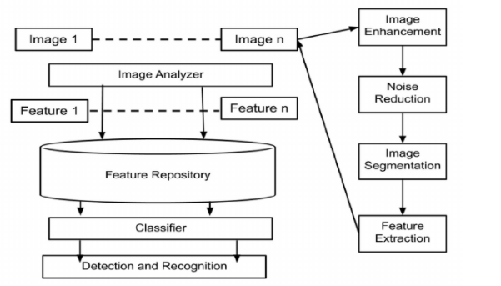
ARCHITECTURAL DESIGN FOR PROPOSED SYSTEM

Slide 10
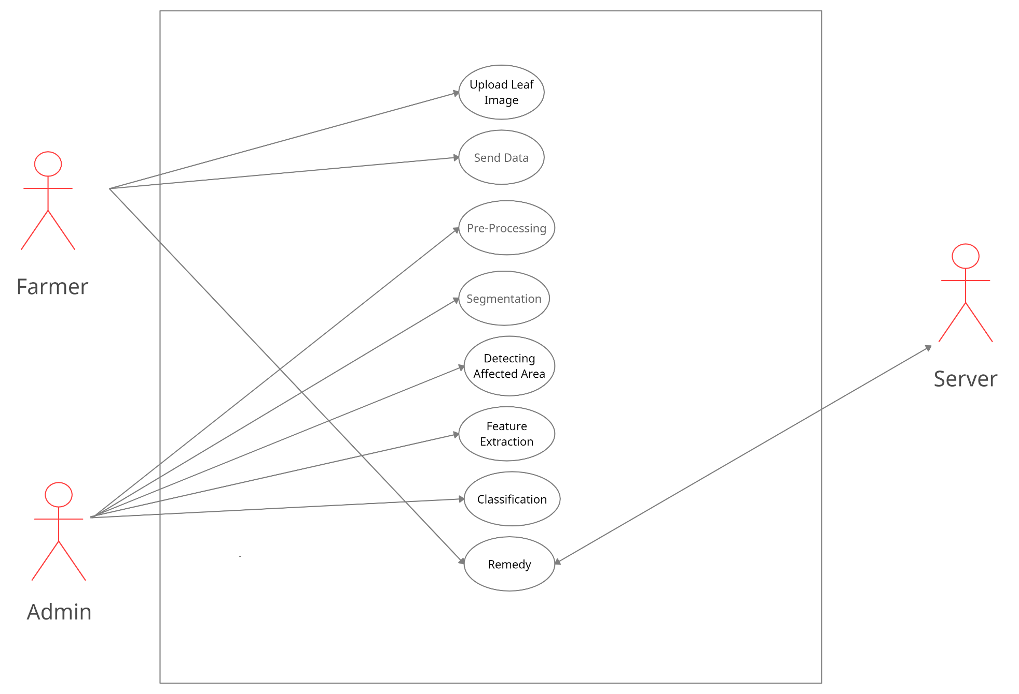
ER/ USE CASE DIAGRAM

Slide 11
ALGORITHM/ TECHNIQUE USED
OpenCV is a Python Library that is used here for Image Processing and Image Segmentation.
Artificial Neural Network (ANN) is a Deep Learning algorithm which can take in an input image, assign importance to various aspects/objects in the image and be able to differentiate one from the other.
The pre-processing required in ANN is much lower as compared to other classification algorithms. While in primitive methods filters are hand-engineered, with enough training, ANN have the ability to learn these filters/characteristics.
ANN is able to successfully capture the Spatial and Temporal dependencies in an image through the application of relevant filters.

Slide 12
EXPECTED OUTCOMES
A smart phone application based on image processing technique which analyzes color features of spots in plants is being developed. Artificial neural networks (ANN) is the most widely used classification technique for classifying plant diseases. The dilemma of costly domain experts will be solved if plant diseases could be detected automatically.
The successful detection of plant disease is very important for cultivation of the crop and this can be done by using image processing.

Slide 13
ADVANTAGE OF PROPOSED SYSTEM
If the image processing and ANN is applied for the automatic disease detection then a low amount of effort will be needed, it will be less time consuming and will be more accurate.
Advantage of using image processing method and ANN is that the leaf diseases can be identified at its early stage. For improving recognition rate, most of researchers used artificial neural networks and classifiers like CNN, SVM, etc.
Early identification of plant diseases would assist farmers in growing crop yields, which would raise India's gross domestic product (GDP).

Slide 14
REFERENCES
Wang P, Niu T, Mao Y, Zhang Z, Liu B and He D (2021) Identification of Apple Leaf Diseases by Improved Deep Convolutional Neural Networks With an Attention Mechanism.
Agarwal, M., Gupta, S. K., and Biswas, K. K. (2020) Development of Efficient CNN model for Tomato crop disease identification.
Uğuz, S. and Uysal, N.: Classification of olive leaf diseases using deep convolutional neural networks.(2020)
Shrivastava, V. K., Pradhan, M. K., Minz, S., and Thakur, M. P.(2019) Rice plant disease classification using transfer learning of deep convolution neural network.
Ozguven, M. M. and Adem, K. (2019) Automatic detection and classification of leaf spot disease in sugar beet using convolutional neural networks.

Slide 15
THANK YOU

